Slide 1
BT201
Biochemical Process Calculations
24/08/2022

Slide 2
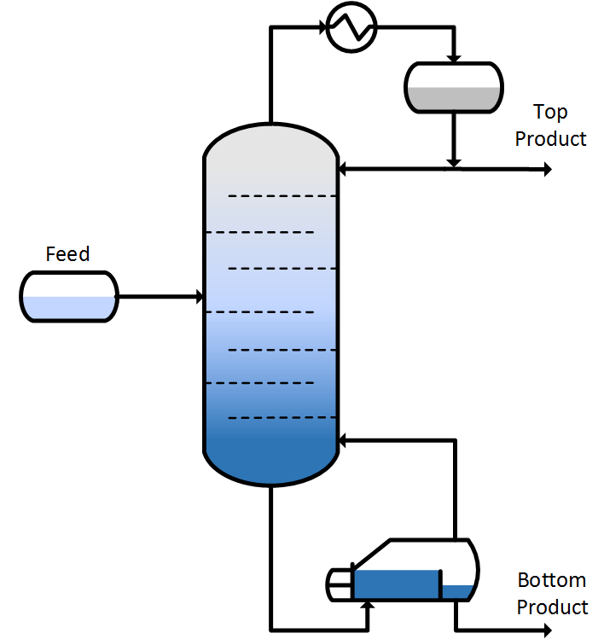
Distillation
Distillation: a separation process exploits the difference in vapor pressure by partially vaporizing a liquid mixture, yielding a vapor relatively rich in some components and a residual liquid relatively rich in other components. For example, recovery of ethanol from an aqueous solution.
In distillation components are separated based on the relative volatility (top product: high volatility and bottom product: low volatility)

Slide 3
Relative volatility
Vapour
A+B
mole fraction of A in vapour: y_{A} or y or y* at equilibrium
T, P_{tot}
Liquid
A+B
mole fraction of A in liquid: x_{A} or x
(α > 1 good separation)

Slide 4
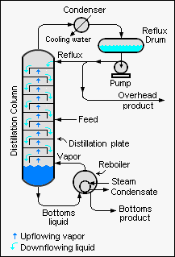
Continues distillation
A continues distillation column is a process unit in which a feed mixture is separated by multiple partial vaporizations and condensations to form two or more product streams.
Distillation columns often consist of a series of vertically distributed stages. Vapor flows upward and liquid flows downward between adjacent stages; some of the liquid fed to each stage vaporizes, and some of the vapor fed to each stage condenses
The vapor leaving the top of a distillation column goes to a condenser in which either total or partial condensation takes place. A portion of the condensate is returned to the top of the column as reflux and the remaining liquid is taken off as the top product reflux and the uncondensed vapor is taken off as the overhead product.
The overhead product stream is rich in the most volatile components of the feed mixture (the ones that vaporize most readily), and the bottom product stream is rich in the least volatile components.
FEED
(A,B…)
.

Slide 5
A liquid mixture containing 45.0% benzene (B) and 55.0% toluene (T) by mass is fed to a distillation
column. A product stream leaving the top of the column (the overhead product) contains 95.0 mole%
B, and a bottom product stream contains 8.0% of the benzene fed to the column (meaning that 92%
of the benzene leaves with the overhead product). The volumetric flow rate of the feed stream is
2000 L/h and the specific gravity of the feed mixture is 0.872. Determine the mass flow rate of the
overhead product stream and the mass flow rate and composition (mass fractions) of the bottom
product stream. Specific gravity: 0.876 (B) and 0.867 (T).
95.0 mol % benzene (B)
Distillation column
92 % benzene (B) fed to the column
Mass flow rate??
2000 L/h
Specific gravity: 0.872
45.0 mass % benzene (B)
55.0 mass % toluene (T)
8 % benzene (B) fed to the column
Mass flow rate??
Mass fractions??

Slide 6
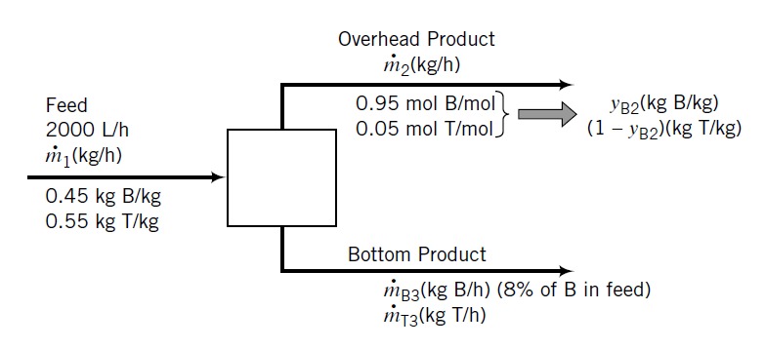
95.0 mol % benzene (B)
92 % benzene (B) fed to the column
Distillation column
Mass flow rate??
2000 L/h
Specific gravity: 0.872
45.0 mass % benzene (B)
55.0 mass % toluene (T)
8 % benzene (B) fed to the column
Mass flow rate??
Mass fractions??

Slide 7
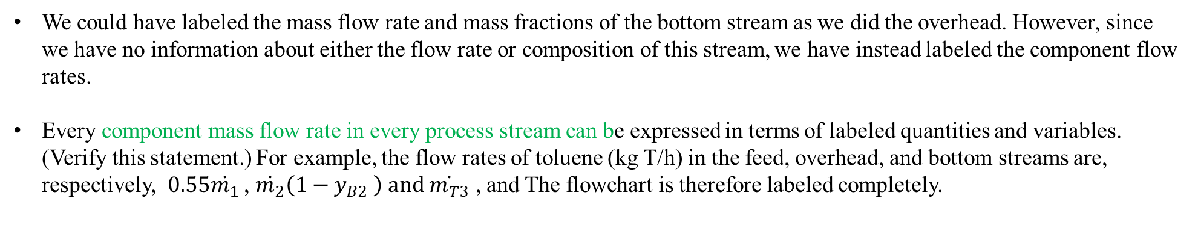
Note several points about the flowchart labeling:
A volumetric flow rate is given for the feed stream, but mass flow rates and fractions will be needed for balances. The mass flow rate of the stream should therefore be considered an unknown process variable and labeled as such on the chart. Its value will be determined from the known volumetric flow rate and density of the feed stream.
Since mass balances will be written, the given component mole fractions in the overhead product stream will have to be converted to mass fractions. The mass fractions are accordingly labeled as unknowns.
Specific gravity: 0.872
We could have labeled the mass flow rate and mass fractions of the bottom stream as we did the overhead. However, since we have no information about either the flow rate or composition of this stream, we have instead labeled the component flow rates.
Every component mass flow rate in every process stream can be expressed in terms of labeled quantities and variables. (Verify this statement.) For example, the flow rates of toluene (kg T/h) in the feed, overhead, and bottom streams are, respectively, $0.55\dot{m_{1}}$ , $\dot{m_{2}}\left(1−y_{B2} \right) and \dot{m_{T3}}$ , and The flowchart is therefore labeled completely.

Slide 8
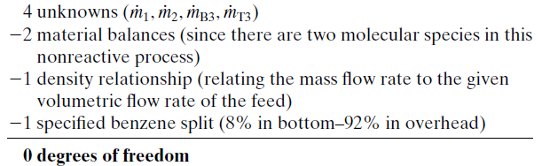
The 8%–92% benzene split between the product streams is not a stream flow rate or composition variable; nevertheless, we write it on the chart to remind ourselves that it is an additional relation among the stream variables and so should be included in the degree-of-freedom analysis.
Degree-of-freedom analysis

Slide 9



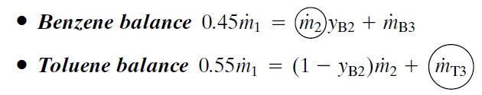




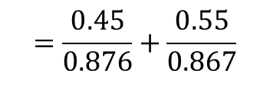


Basis: 2000 L/h feed flow rate
$$Feed density$$
$$=\frac{0.45}{0.876}+\frac{0.55}{0.867}$$
$$Feed average density=0.872kg/L$$
$$Feed mass flow rate,$$
$$=1744 kg/h$$
Benzene split fraction
$$=62.8 kg/h$$
$$Still two unknown$$
2 Components balance

Slide 10


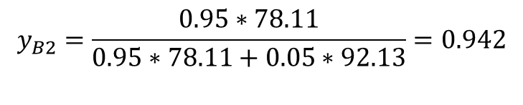
molecular weights of benzene (78.11) and toluene (92.13)
$$y_{B2}=\frac{0.95∗78.11}{0.95∗78.11+0.05∗92.13}=0.942$$
Bottom product mass flow rate=1744-766=978 kg/h
Alternatively: Bottom product mass flow rate=62.8+915=978 kg/h
Mass fraction of B in bottom product=62.8/978=0.064
Mass fraction of T in bottom product=1-0.064=0.936

Slide 11


Crystallization
Formation of solid particles/crystals within a homogeneous phase by modifying the solubility of the component of interest
The change in solubility is accomplished by:
decreasing the temperature of the solution (cool down)

Slide 12
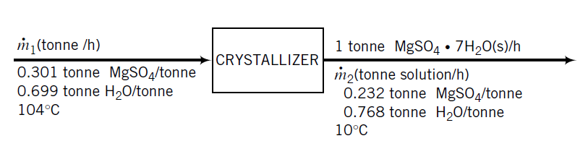
An aqueous solution of magnesium sulfate at 104 C containing 30.1 wt% MgSO is fed to a cooling
crystallizer that operates at 10 C. The stream leaving the crystallizer is a slurry of solid magnesium
sulfate heptahydrate particles [MgSO4 7H2O(s)] suspended in a liquid solution. Solubility
data for magnesium sulfate show that a saturated solution at 10 C contains 23.2 wt% MgSO4 Determine the rate at which solution must be fed to the crystallizer to produce 1 metric ton (1 tonne, 1000 kg) of magnesium sulfate heptahydrate per hour.
Two unknowns on the chart ( $\dot{m_{1}}$and $\dot{m_{2}}$) and two independent molecular species on which balances may be written (MgSO₄ and H₂O), so that the problem can be solved

Slide 13
